Slide 1
Monopoly
Amisha Chhetri
Zeke Farkas
Elizabeth Raynor
Michelle Pham
Notes:
What was your team project?

Slide 2



CoronaVirus
Notes:
Amisha
Establish required background for the problem domain so that everyone knows what you are talking about
If possible, establish a motivation for your problem domain. Why is this an important project? (NOTE – this is probably not really possible for games, unless you can find a scientifically interesting algorithm or approach you used for your game.)

Slide 3
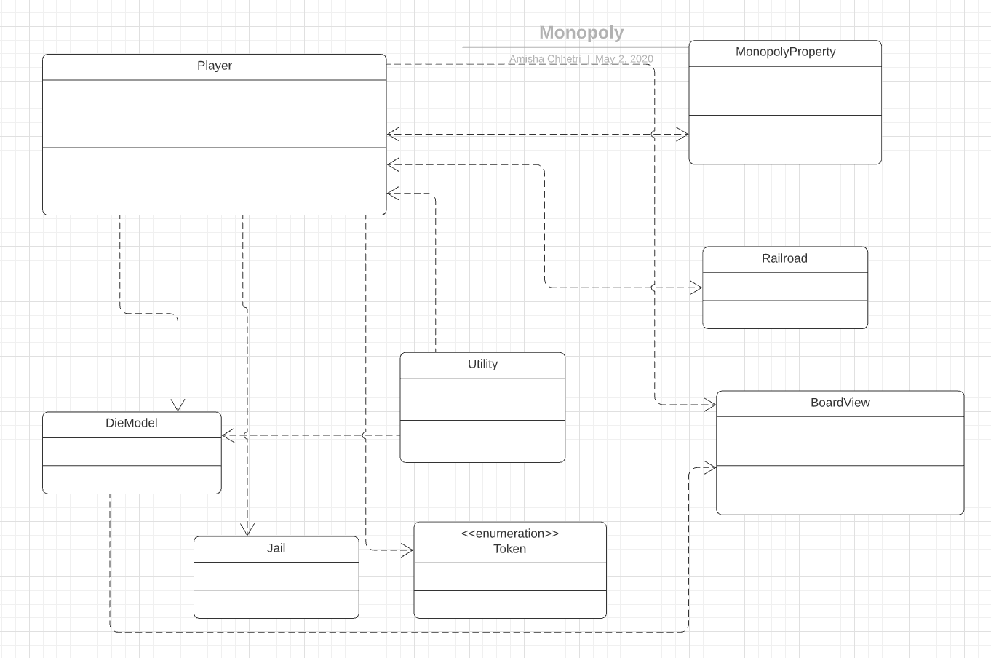
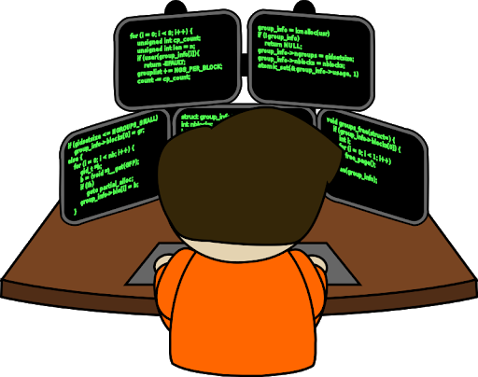
Main Classes
Notes:
ZEKE
What were the major classes implemented? Present a very basic UML class diagram that includes only the class names and important relationships! Make sure it's readable by the listener! And more importantly, make sure you can clearly explain it! Keep unnecessary details out, such as fields and methods. Make a diagram that has only the class names, relationships between the classes. Include only those fields and methods that are an integral part of your design and are relevant for your presentation.
Any interesting data structures out of the ordinary? Discuss it!
Did you use any advanced data structures of your own, or from the Java API? What were the major algorithms used? (e.g. if you implemented a computer player, how did you govern how the computer plays? Did you apply any AI algorithms? Or brute force? What rules did you use?
****I’m making the UML for this rn

Slide 4
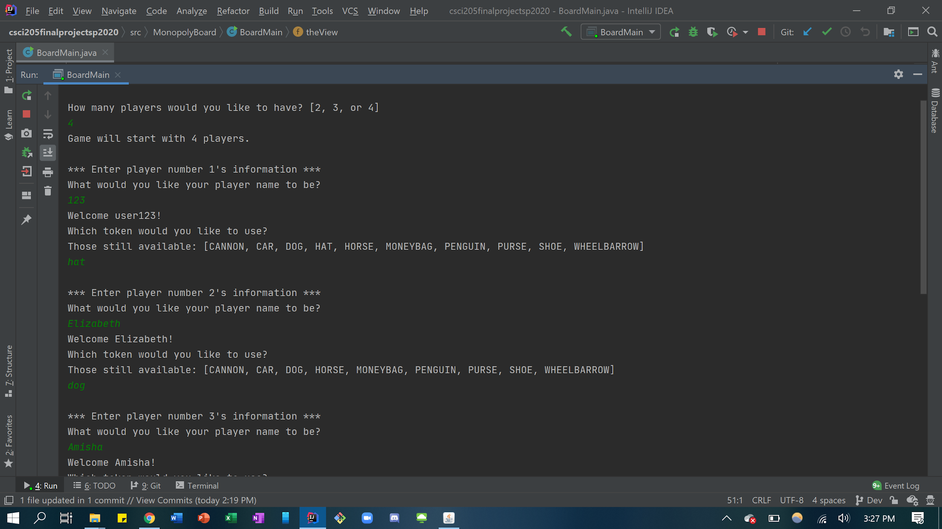
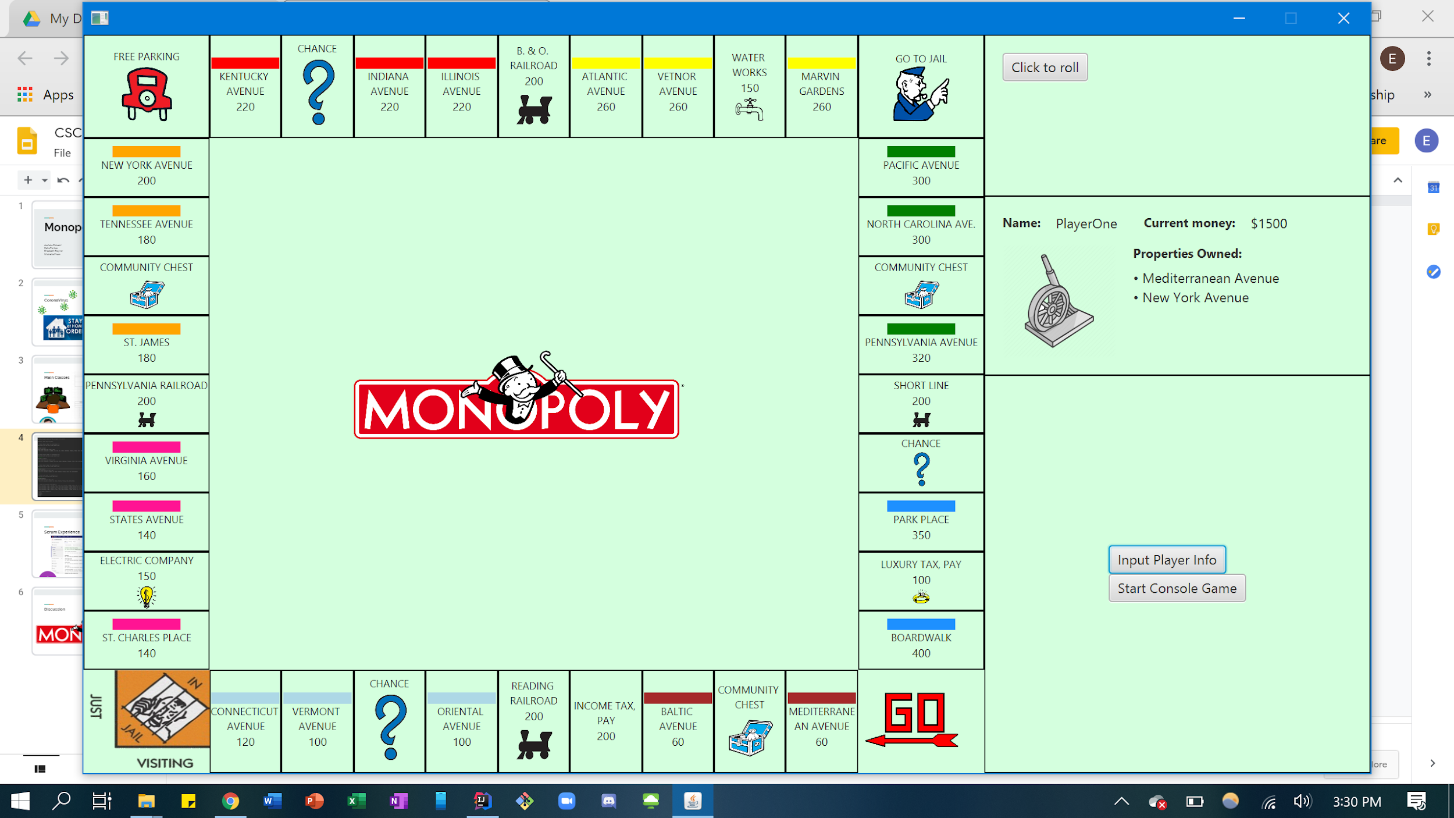
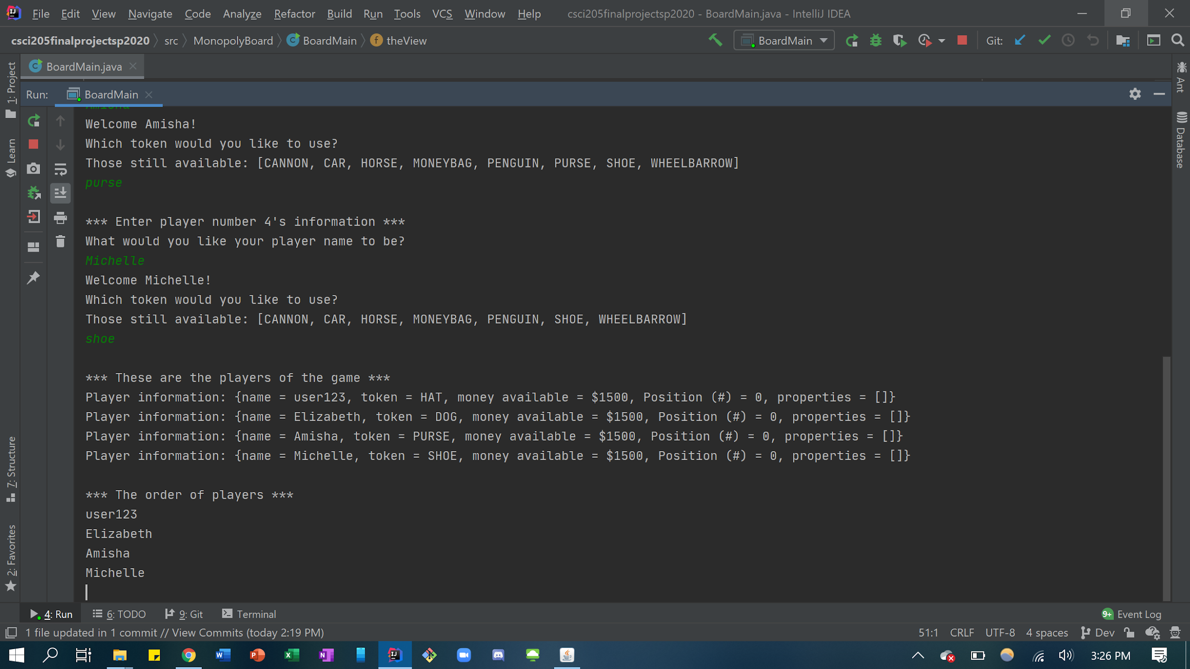
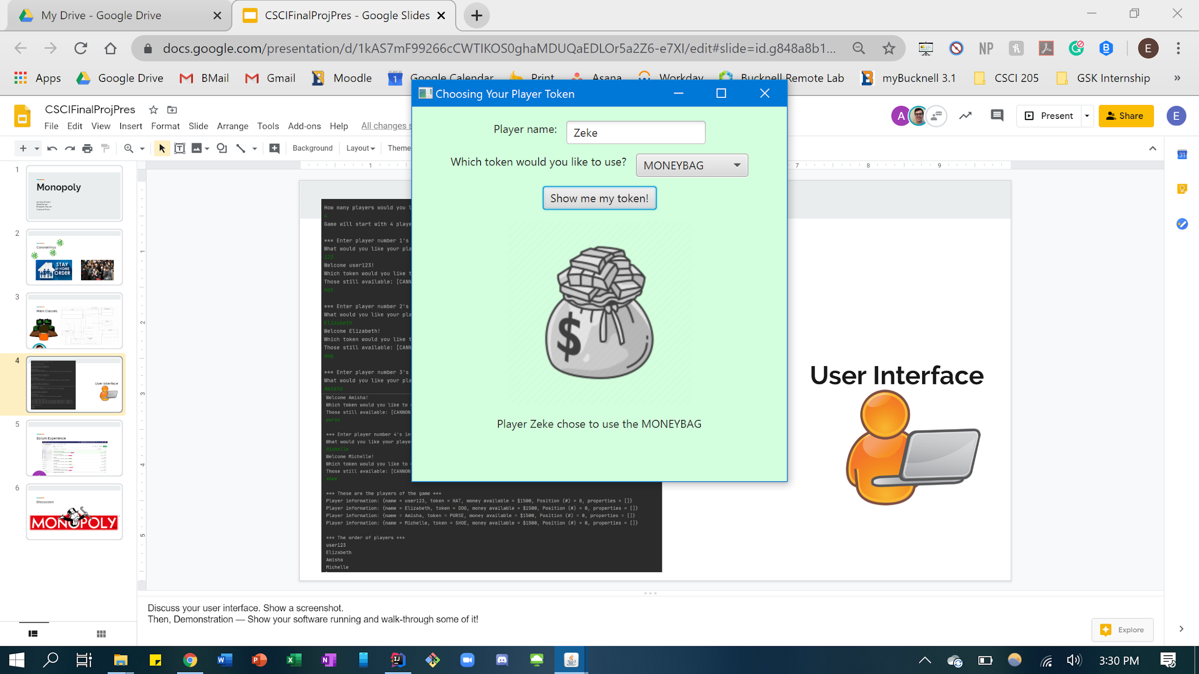

User Interface
Notes:
Discuss your user interface. Show a screenshot.
Then, Demonstration — Show your software running and walk-through some of it!

Slide 5
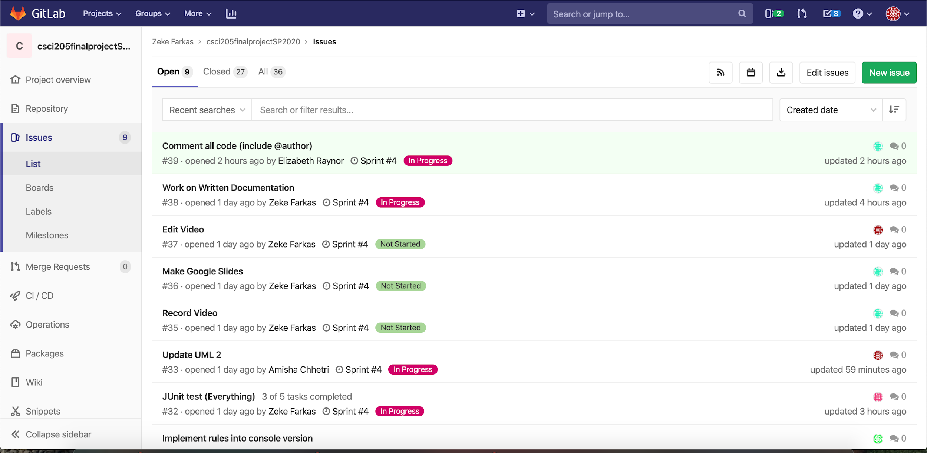
Scrum Experience
Notes:
Discuss your Scrum experience
Describe a few key user stories
Talk openly about the process. Point out 1-2 strengths, 1-2 weaknesses or challenges. What would you do differently on your next agile project?
Our groups scrum experience was very positive. It really helped us with organizing our ideas and making it come to life.
One of our main user stories that we focused on a lot is As a visual person, I want a board that looks much like the real monopoly board so that I feel like I’m really playing the game.
We used JavaFX to give that experience to our players.
Scrum helped keep us on our toes, we knew exactly what other people in the team were working on, it helped a lot with brainstorming and planning out what we wanted to do before we got to coding, lastly, it helped us achieve what we wanted to get done.
However, there were also some weaknesses with using scrum as a student. For example, we had other classes while we were doing this project and it was hard doing something each day so that we had something to talk about and write in our daily scrums. Especially that time when we also had hw1 and hw2, it was hard balancing everything at once. However, we do believe that this is a great resource for a workplace environment.
Key user stories - “As a visual person, I want a board that looks much like the real monopoly board so that I feel like I’m really playing the game”
Strength - great organization, kept us on our feet, everyday we spent time working on things, no blame, everyone worked on things, very organized, planning up front, helped us what we wanted to get done
Weakness - this isn’t our only class, so time commitment. We couldn’t do so much in between scrum meetings, 5 scrum meetings a week was too much, especially with hw 1 & 2, scrum is better suited for a workplace environment than academics with so many classes and projects

Slide 6

Discussion
Notes:
Conclude by discussing challenges in the project, what you learned, and what you would change if you could release version 2.0, and why.
2.0
Integrating controls with board
Reallocating time - more functioning
What we learned
JavaFX, GIT, jar files, markdowns
Challenge
Time constraint

